Slide 1
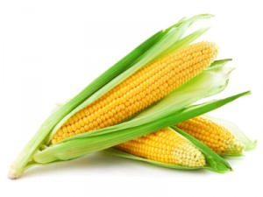
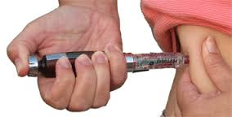
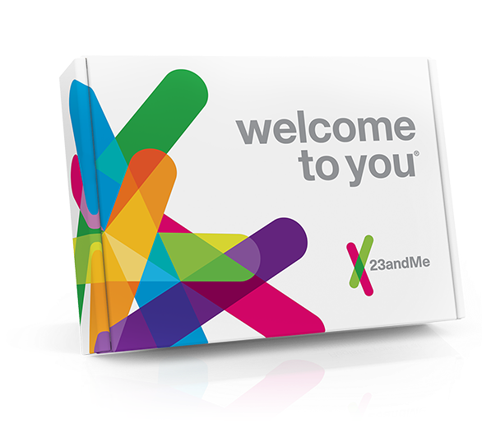
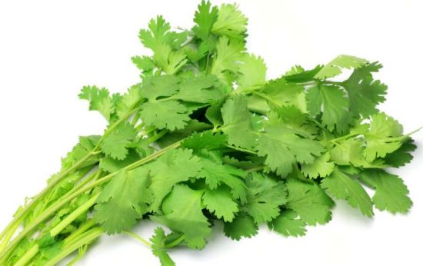
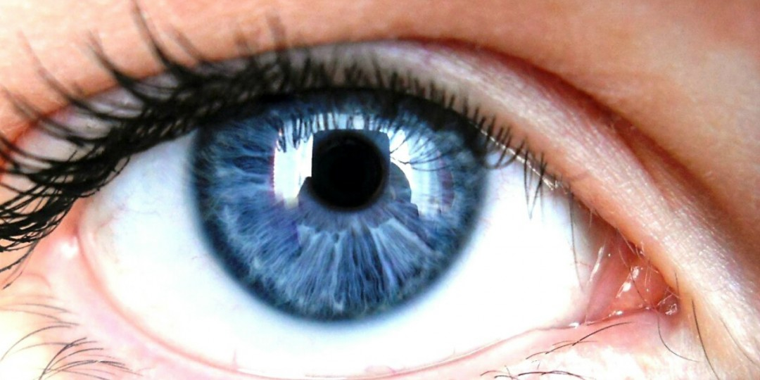
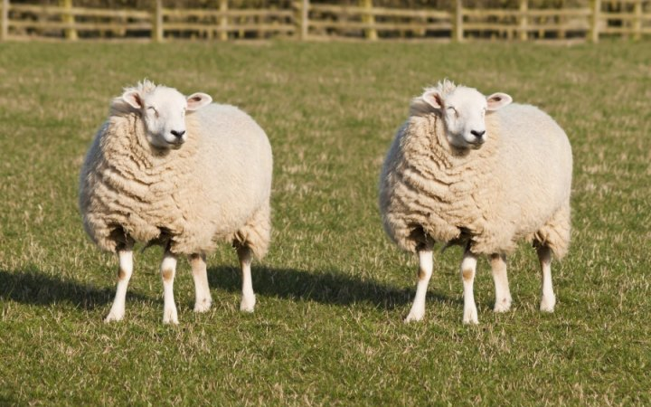
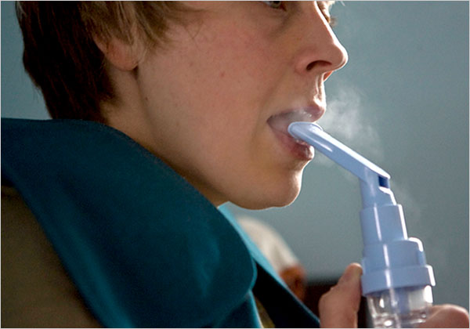
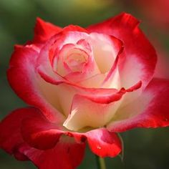

Slide 2
Genetics

Slide 3
DNA
What does DNA stand for?
Where is it found?
What are the building blocks of a DNA molecule? (Clue: bases)
How would you describe the structure?

Slide 4
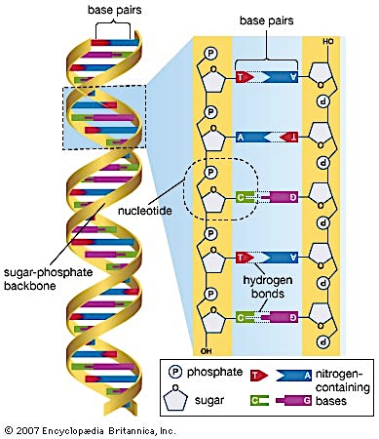

Slide 5
Genes
Where are genes found?
What are genes made of?
What is the function of a gene?

Slide 6
Chromosomes
What are chromosomes made of?
How many chromosomes are found in human cells? Is it the same for all cells?
What is the relationship between chromosomes, DNA and genes?

Slide 7
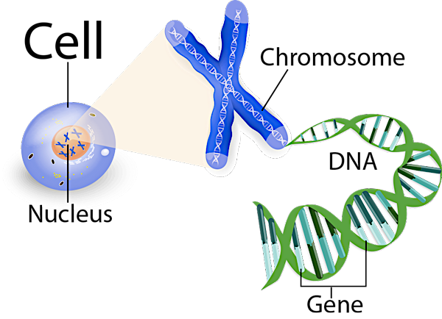

Slide 8
Alleles
What are alleles?
What is a dominant allele? What is a recessive allele? And how is it represented?
What does it mean to be heterozygous?
What about homozygous?

Slide 9
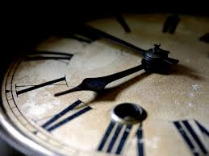
Population
A population is a group of organisms of the same species living together in a particular place at a particular time

Slide 10
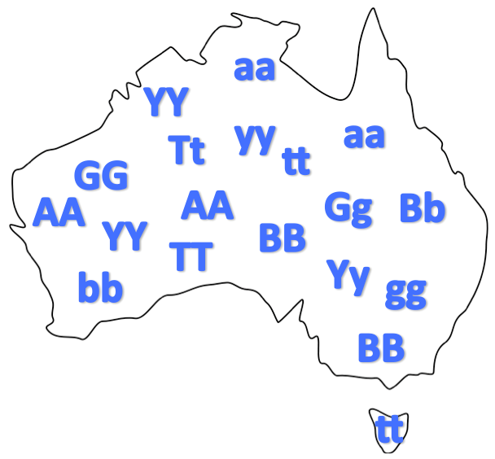
Gene pools
The sum of all alleles in a given population

Slide 11
Mutations
A permanent change in a gene or chromosome.

Slide 12
Mutations
A permanent change in the base sequence of the DNA.
Mutant organism with a characteristic resulting from a mutation
Two main types of mutations Gene & chromosomal
Can occur randomly or can be induced

Slide 13
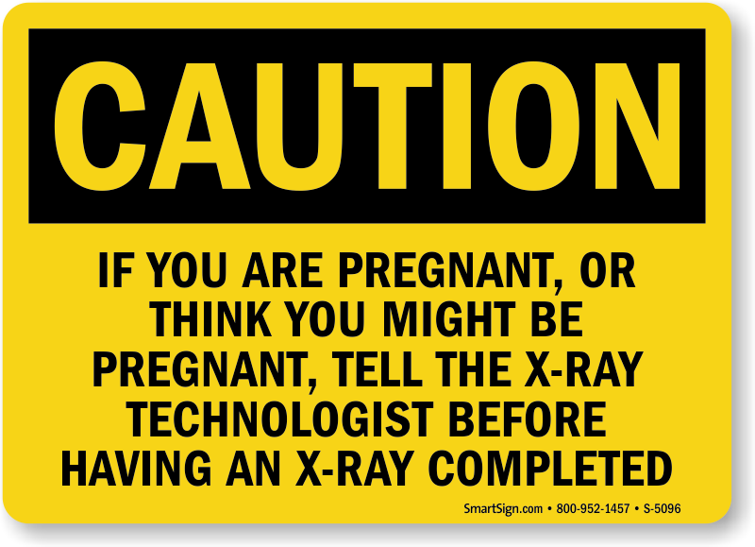
Mutagens
Mutagens/mutagenic agents increase the rate of mutations

Slide 14
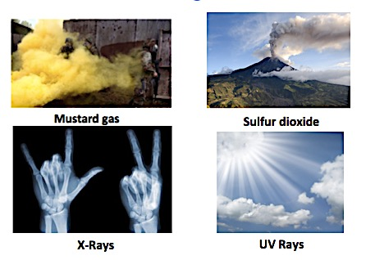
Mutagens

Slide 15
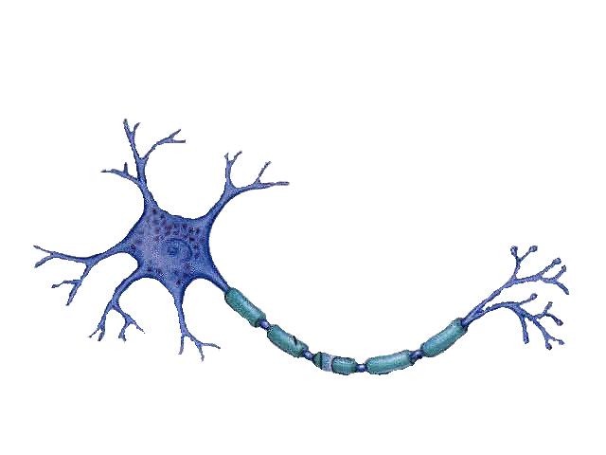
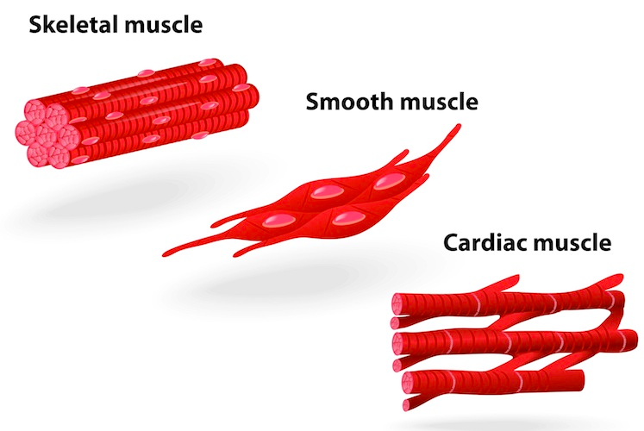
Somatic Mutations
Affects body cells
Only the individual is affected
Involved in cancerous growths

Slide 16
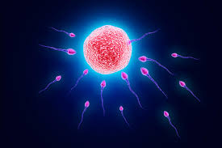
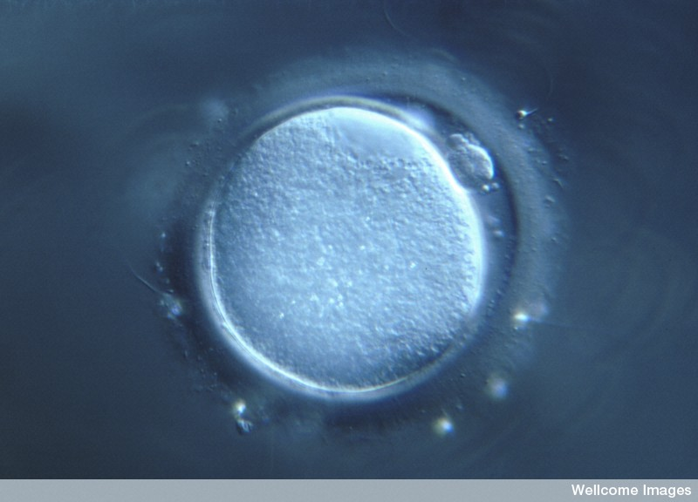
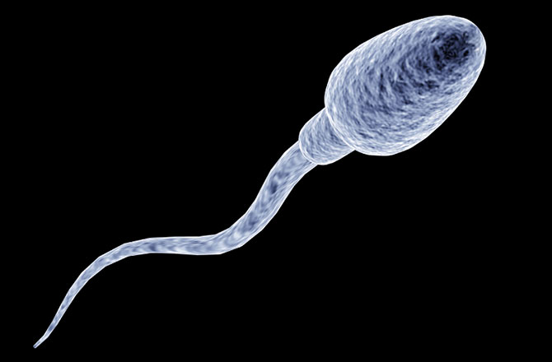
Germline mutations
Mutations occur in gamete cells
Individual normally not affected
Passed on to offspring
Affected embryos are naturally aborted
Eg. PKU

Slide 17
Quick quiz
What is the name given to a group of organisms of the same species living together in a particular place at a particular time?
Define a gene pool
What are the two main types of mutations?
Name one difference between somatic and germline mutations

Slide 18
Quick quiz
Population
The sum of all alleles in a given population
Gene and chromosomal
Somatic individuals affected, occurs in body cells Germline offspring affected, occurs in gametes

